Slide 1
You and your Mental Health
Dr Falade Joshua
[ Cert in Tobacco Rx (Ontario), RN(nig), MBBS(nig), MSc (nig), FMCPsych(nig), {EMDAS(italy), PGD(nig), MD(nig)} in view]
Consultant Psychiatrist/Addiction Physician/ Senior Lecturer

Slide 2
Outline
Definition
SDGs and Mental Health
How common is Mental Illness
Common Presentations of Mental Illness
Common Mental Illnesses
How to Protect your Mental Health
Conclusion

Slide 3
Definition
Health is a state of complete physical, mental and social well-being and not merely the absence of disease or infirmity (Official Records of WHO, no. 2, p. 100) .

Slide 4
What is Mental Health?
Mental health is a state of well-being in which an individual realizes his or her own abilities, can cope with the normal stresses of life, can work productively and is able to make a contribution to his or her community.

Slide 5
Mental Ill Health
Mental illnesses are health conditions involving changes in emotion, thinking or behavior (or a combination of these).

Slide 6
SDG and Mental Health
The Sustainable Development Goals (‎SDGs)‎ was introduced to continue the progress made by the MDGs, by incorporating the lessons learnt in charting a new way forward, with emphasis on ensuring that no one is left behind

Slide 7
SDG and Mental Health
SDG 3 is to ensure healthy lives and promote well-being for all at all ages and has 13 targets measured through 26 indicators.
However, a person’s health and well-being are affected not only by disease and treatment, but also by social and economic factors such as housing, poverty and education

Slide 8
SDGs and Mental Health
Items that are directly linked to Mental illness
Items that are Mental Health Issues

Slide 9
How common is Mental illness ?
Mental disorders are among the most prevalent classes of chronic diseases in the general population, with lifetime-to-date prevalence often close to 50% of the population and with 12-month prevalence typically in the 15–25% range( WHO 2020)

Slide 10
In Nigeria, an estimated 20%–30% of our population are believed to suffer from mental disorders (Family Characteristics and Mental Health Status of Secondary School Students in a Rural Community in Southwest Nigeria C. E. Nwachukwu,A. E. Akingbade,E. O. Olufunmilayo,T. A. Oyebamiji,O. F. Odefemi,B. N. Ikwunne,V. B. Adeyeye,O. O. Ojo,A. M. Adebayo International Journal of Mental Health and Addiction. 2021; )

Slide 14
Risk Factors for Mental illness
Family history of mental illness
Parental Separation, Early parental deprivation
Dysfunctional Family system
History of Abuse(Physical , sexual, emotional)
Recent traumatic events ( death, failure etc)
Recent change of role or status
Recent added responsibility
Relationships problems
Carrier Choice and progression

Slide 15
Common Presentations of Mental Illness
Excessive Sadness
Excessive Happiness
Poor Sleep
Lack of concentration
Mood Swings
Irritability and excessive hanger
Abnormal Behavior

Slide 16
Common Presentations of Mental Illness
Excessive Fear
Abnormal Belief
Excessive Hearing of voice of unseen people
Excessive Talking to self
Abuse of Psychoactive Substance
Suicidal thought / Ideation

Slide 17
Common Mental Health disorders
Depression

Slide 18
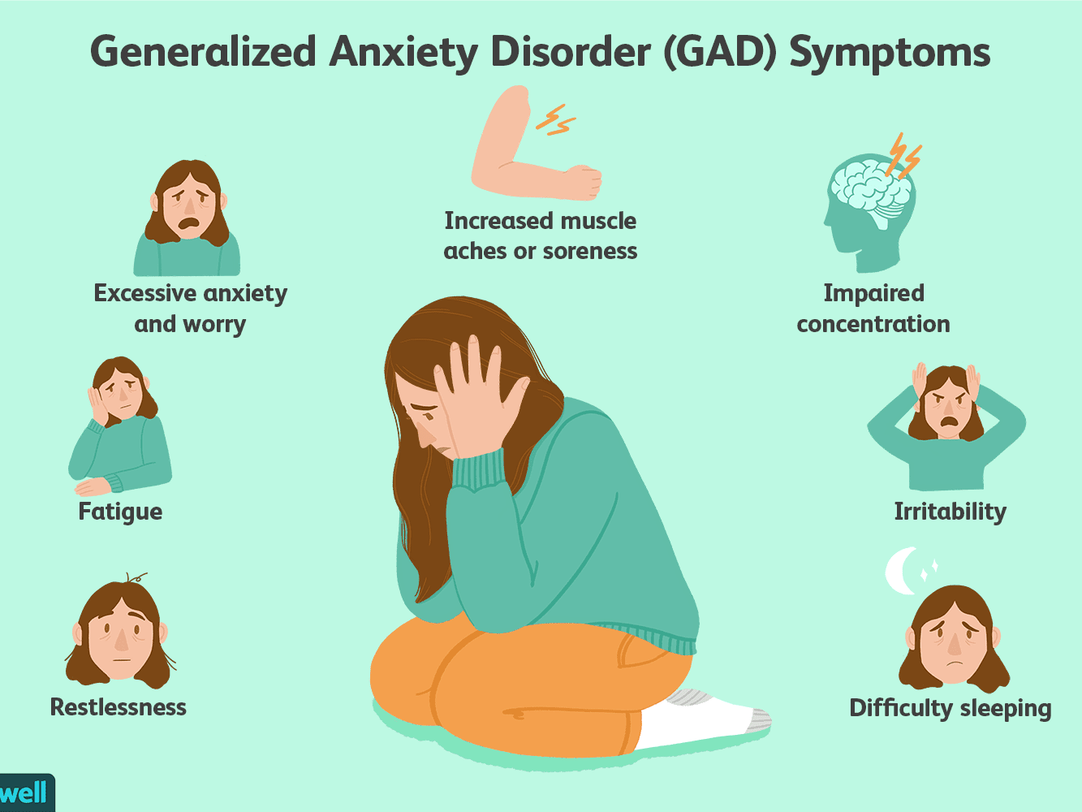
Common Mental Health disorders...
Anxiety disorders

Slide 19
Common Mental Health disorders...
Substance Use Disorders

Slide 20
Common Mental Health disorders...
Sleep disorders

Slide 21
Common Mental Health disorders...
Bipolar Affective Disorder

Slide 22
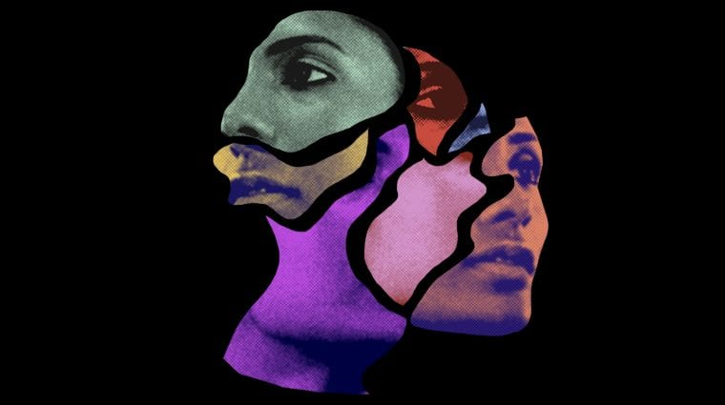
Common Mental Health disorders...
Psychosis

Slide 23
How to protect your mental Health
Protect your Physical Health
Regular Physical and Mental Examination
Adequate Rest
Exercise
Setting goal (SMART)
Specific
Measurable
Accurate
Realistic
Time bound

Slide 24
Use of Adaptive Coping Strategies
Talk with Mental Health expert when you psychologically down,
Positive reframing,
Acceptance
Religion
Humor
Active coping planning

Slide 25
Use of Adaptive Coping Strategies...
Seeking help
Solving problem
Obtaining information
Ventilating

Slide 26
Early diagnosis and treatment
Use of Drugs
Psychological treatment
Social treatment

Slide 27
Management of disability
Rehabilitation

Slide 28
Conclusion
There is no health without Mental Health
See the University Counselors and Members of the Mental Health Team for advice , diagnosis and treatment

Slide 29
Recommendations
Parenting Styles and principles and it’s relationship with Emotional Intelligence should be understood by Parents and Caregivers
Regular Mental Health Screening along side with the General Medical Check
Mental Health issues should be duly managed to prevent Mental Illness

Slide 30
Parting words
“If you feel , see or hear something that others can’t see , hear or feel please you need to see a Mental Health Expert”.

Slide 31
SHALOM

